Slide 1


2011 TREND REPORT SAMPLE
Nov 1, 2010 - Brought to you by Trend Hunter, the world’s largest, most popular trend network. From CEOs to entrepreneurs, those looking for new ideas routinely source our trend reports.

Slide 2
COPYRIGHT
Please share only with your immediate team
The TREND HUNTER Trend Report is for your immediate team’s use only.
Please do not distribute, publish or present outside your team.
Trademarks & Copyright
'Trend Hunter' is the legally registered trademarks of Trend Hunter Inc. Trend Hunter and its corporate graphics are copyright © by Trend Hunter Inc.
Images posted in our articles are readily available in various places on the Internet and believed to be in the public domain. Images posted are believed to be posted within our rights according to the U.S. Copyright Fair Use Act (title 17, U.S. Code). If you believe that any content appearing on Trend Hunter infringes on your copyright, please contact us and the infringing material will be removed as soon as possible.
Copyright © TrendHunter.com. All Rights Reserved

Slide 3
TREND HUNTER
2011 TREND REPORT
CROWD SOURCED
INSIGHTTM
Background
About Trend Hunter and This Report
Sample Trend Clusters
Chosen From 250+ Patterns of Inspiration in the 2011 Trend Report
3
Notes:
Removed Zeitgeist

Slide 4
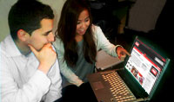


When eBay, Pepsico and Google need to kick start innovation….
Every day, leading brands use our "unrivaled trend report platform" to deeply understand consumer trends, identify opportunities and make decisions with more confidence.
With Trend Hunter PRO, they gain access to the world's largest, most updated trend research. Instead of relying on a few trend spotters, they leverage the collective insight of 38,000 Trend Hunters and the patterns that emerge from 350,000,000 views of data.
Now more than ever, economic uncertainty is giving birth to new consumer needs and opportunity. With our quantified consumer insight, you will shape your ideas, track evolving consumer needs and steal market share from less-informed competitors.
    Jeremy Gutsche
    Chief Trend Hunter, TrendHunter.com
    jeremy@trendhunter.com / jeremygutsche.com
Copyright © TrendHunter.com. All Rights Reserved

Slide 5
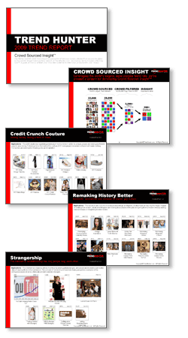
6 THINGS TO KNOW
Your new report has several distinctions you should know
1. Ongoing Updates
2. Crowdsourced & Crowd Filtered
3. Hyperlinked Examples
4. Measured Scores
5. Acclaimed Content
6. In-Depth Reading View

Slide 6
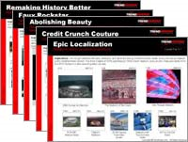

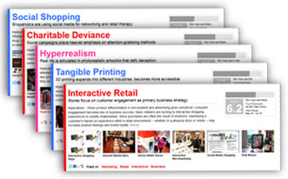
1. ONGOING UPDATES
With your subscription, you gain access to 50+ reports and 1,000+ PRO Trends linked to 40,000+ examples!
+
50+ Reports
Fashion
Business
Design
Social
Technology
Retail
Pop Culture
Marketing
+ MORE!
Online Access
World’s largest,
most updated
database of
consumer trends
1,000+ PRO Trends
40,000+ Examples!

Slide 7
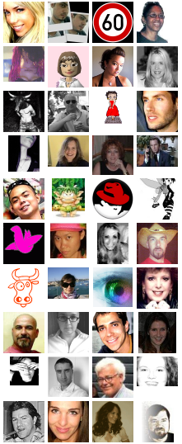
2. CROWDSOURCED & FILTERED
The reports are global, based on crowdsourced and crowd filtered content from Trend Hunter, the world’s #1 trend site
CROWDSOURCED
World’s Largest Trend Network
CROWD FILTERED
300,000,000+ Page Views
INSIGHT
Inspirational Ideas
40,000
Trend Hunters
100,000
Micro Trends
40,000
Micro-Trends
“The Best”
1,000+
PRO Trends

Slide 8
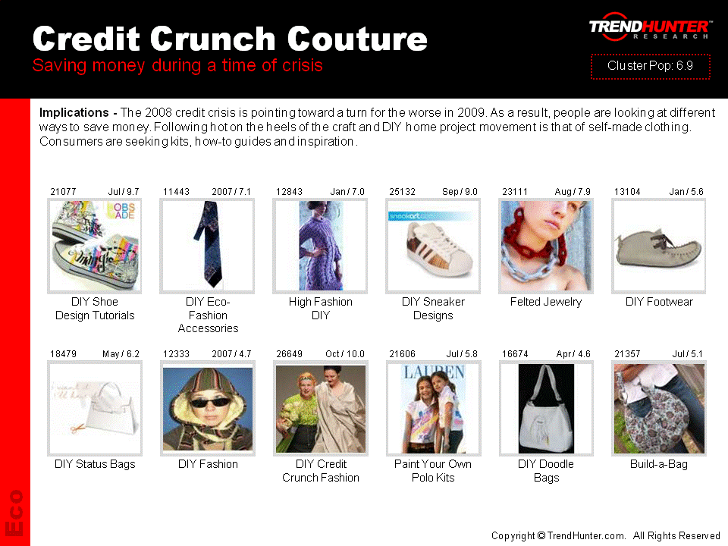
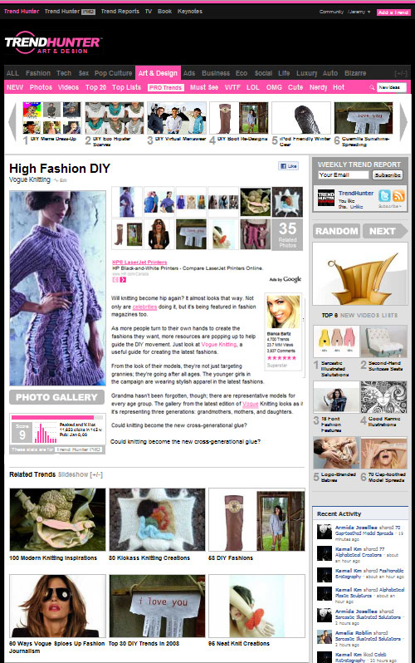
3. HYPERLINKED 4 MORE
Every example is hyperlinked to our free online articles, which in many cases include galleries and videos
GET MORE:
Details
Galleries
Videos
Sources

Slide 9
4. MEASURED [SCORE]
We score micro-trends for popularity, leveraging
300,000,000+ views. High scores excite consumers!
Traffic Score – Relative Popularity
Normalized by Month & Capped
Example:
A score of 10 means the trend received at least 5x the traffic of an average trend
Relative Traffic
Traffic Score

Slide 10
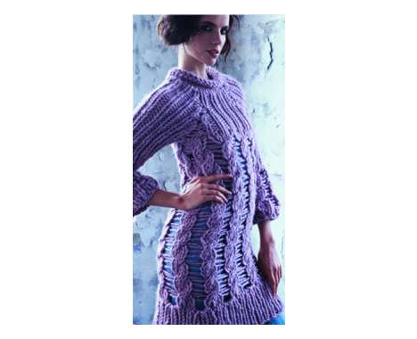
4b. MEASURED [HOW TO READ]
Each of the micro-trends includes useful information including discovery date and the relative traffic score
Trend ID
Open any trend using its ID:
TrendHunter.com/ID/XXXX
Discovery Date
This may be before or after the product has been released, but discovery is a useful measure because it reflects when the web community took notice.
12843
June / 8.0
Traffic Score
Out of 10, this is a measure of traffic relative to other posts on Trend Hunter during the same month.
>5 : Above Average
>7 : Hot
>9 : On Fire
High Fashion DIY
Hyperlinked Picture
Click on any picture (in PRESENTATION MODE) to open the full article. This can include galleries, videos, and product links

Slide 11


5. ACCLAIMED CONTENT
Last, enjoy the content! You’re reading examples from the freshest source of cutting edge trends!
Featured in:
Clients:

Slide 12



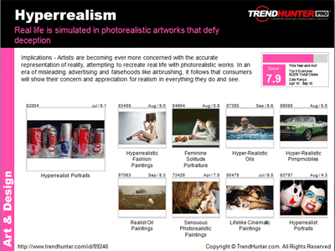
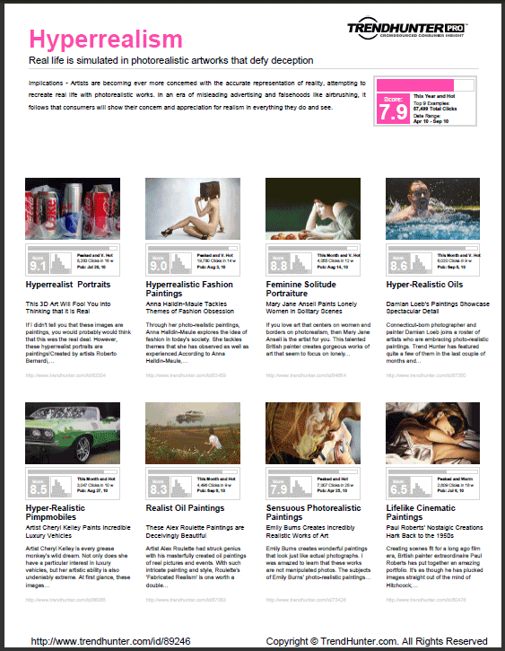
6. In-Depth Reading Version
In addition to the PPT and PDF presentations, you’ll now get an in-depth reading view which provides more details about each example
+

Slide 13
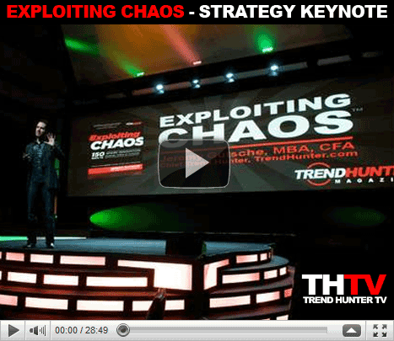

BONUS: HOW TO INNOVATE
To get the most of your subscription, watch our 30 minute video of EXPLOITING CHAOS, and as a subscriber, we’ll send you the book!
Free 30 Minute Training Video
Video at: JeremyGutsche.com
Innovation Book
FREE for Trend Report Subscribers

Slide 14
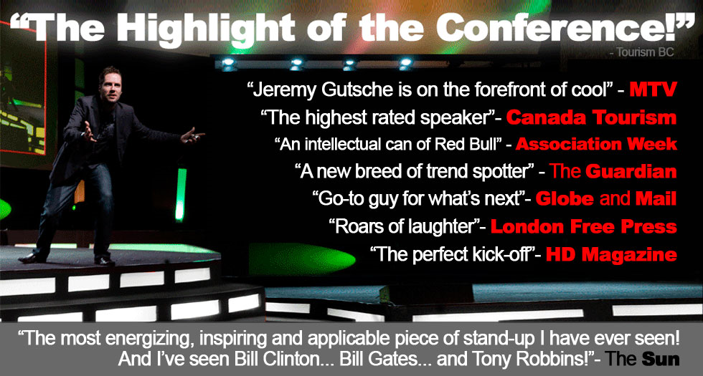
Keynotes & Workshops
If you really want to kick-start your team’s innovation, contact us about booking a keynote and workshop: Videos at JeremyGutsche.com

Slide 15
TREND HUNTER
2011 TREND REPORT
CROWD SOURCED
INSIGHTTM
Background
About Trend Hunter and This Report
Sample Trend Clusters
Chosen From 250+ Patterns of Inspiration in the 2011 Trend Report
15
Notes:
Removed Zeitgeist

Slide 16





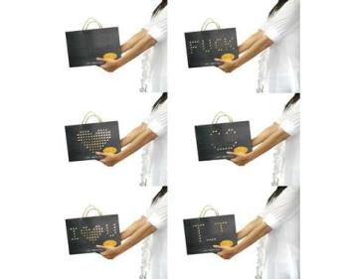
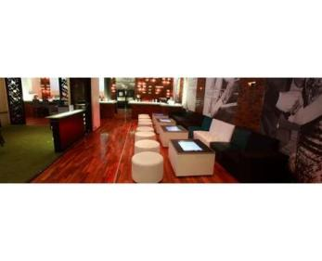
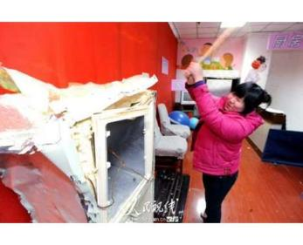

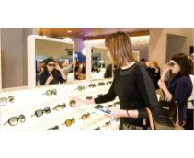
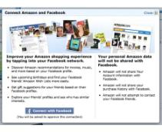
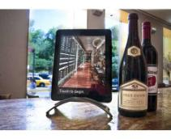
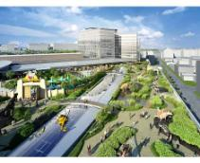
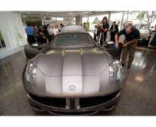
Interactive Retail
Stores focus on customer engagement as primary business strategy
Implications - When product differentiation is non-existent and advertising goes unnoticed, consumer engagement becomes key in business success. Many retailers are turning to interactive shopping experiences to solidify relationships. Since purchases are often the result of emotions, maximizing a customer's hands-on experience within a retail environment -- whether in a physical store or online -- may increase positive feelings and brand loyalty.
Score:
This Year and Warm
6.2
Top 8 Examples:
49,863 Total Clicks
Date Range:
May 10 - Jul 10
80403
Jul / 9.6
76874
May / 7.2
81359
Jul / 6.5
Interactive Shopping Bags
Internet Martini Bars
Stress-Relief Stores
82200
Jul / 6.1
82888
Jul / 5.8
82355
Jul / 5.4
82764
Jul / 4.3
80891
Jul / 4.3
Marketing
Interactive Merchandising
Social Media Shopping
iPad Menus
Dinosaur-Themed Malls
Plug-In Auto Dealerships
http://www.trendhunter.com/id/84722 Copyright © TrendHunter.com. All Rights Reserved

Slide 17
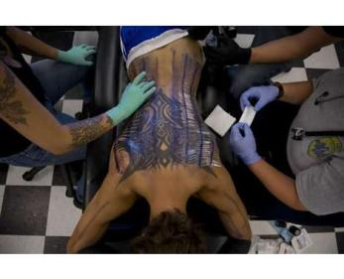
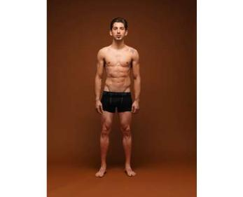
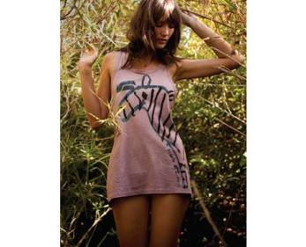
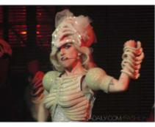
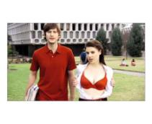
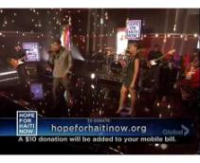
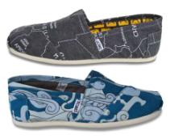
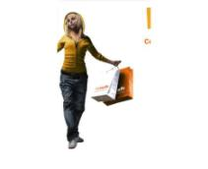
Charitable Deviance
Social campaigns place heavier emphasis on attention-grabbing methods
Implications - In a society where charities abound, it is becoming harder for the social-minded consumer to choose where to donate his or her money and time. Competition amongst charities and social initiatives has risen steadily, which has provided the impetus for an increase in unique and innovative charitable projects, some even bordering on bizarre.
Score:
This Year and Warm
6.4
Top 8 Examples:
81,782 Total Clicks
Date Range:
Jan 10 - Jul 10
80033
Jul / 10.0
80296
Jul / 7.7
77794
Jun / 6.8
Charitable Body Modifications
Gruesome Charity Art
Fashionable Charity Tees
67081
Feb / 6.7
73893
Apr / 6.5
65159
Jan / 5.3
76380
May / 4.1
76487
May / 4.0
Social
Charitable Corsets
Charitable Stripping
Charitable Earthquake Anthems
Charitable Hemp Footwear
Upcycled Charity Creations
http://www.trendhunter.com/id/88731 Copyright © TrendHunter.com. All Rights Reserved

Slide 18

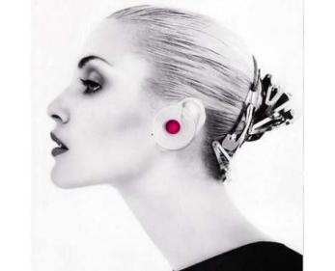
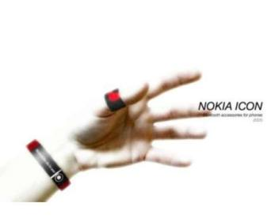
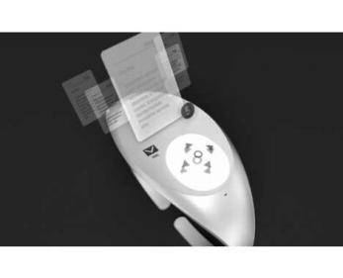
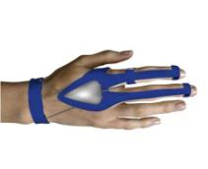
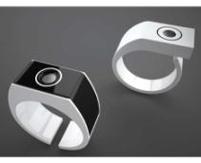
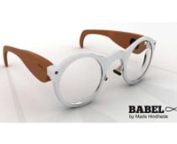
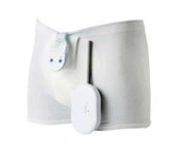
Wearable Tech
Gadget-infused accessories make for easy connectivity
Implications - Making their way into the hearts of the fashionable and geeky alike are stylish, hi-tech accessories that can do everything from monitor your blood pressure to control your iPod. With a rising preference for portability and easy-to-use technology, it's no surprise that many designers are trying to merge fashion and function.
Score:
This Year and Warm
5.6
Top 7 Examples:
27,515 Total Clicks
Date Range:
Sep 09 - Jul 10
53085
Sep / 7.3
79175
Jun / 7.1
78585
Jun / 6.9
Spiral Earring Phones
Caller ID Bracelets
Holographic Wrist Phones
65728
Jan / 5.6
79883
Jun / 4.7
80185
Jul / 4.4
71814
Apr / 3.2
Fashion
Gloved Mouses
UV Ray Rings
Lens-Powered Listening Gadgets
Texting Underpants
http://www.trendhunter.com/id/80569 Copyright © TrendHunter.com. All Rights Reserved

Slide 19
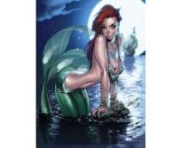
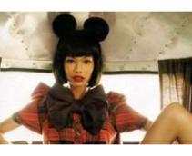
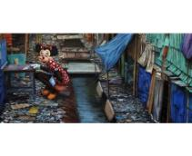
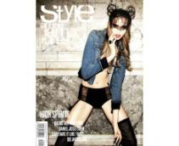
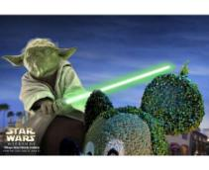
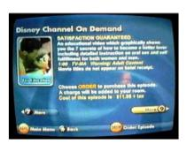
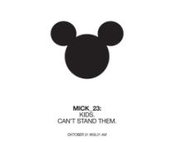
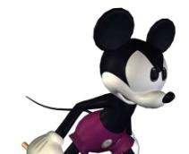
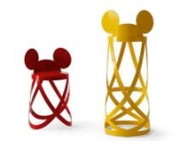
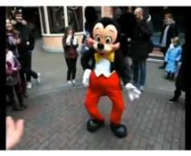
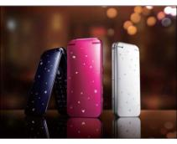
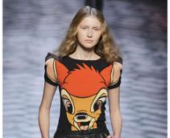
Brand Reversion
Nostalgia opening the door for childhood brands
Implications - The continual search for nostalgic, childhood symbols indicates that consumers may want more than the imposing, mega-brands of today. The Walt Disney Company has managed to capture--and stay in--the hearts of consumers, as well as inspire products in everything from furniture to fashion. Thus, being yesterday's long-established brand may prove more beneficial in today's crowded marketplace.
Score:
This Year and Hot
7.6
Top 9 Examples:
330,500 Total Clicks
Date Range:
Oct 09 - May 10
73498
Apr / 10.0
59668
Nov / 9.6
75003
May / 9.5
75608
May / 8.9
74698
May / 6.7
66744
Feb / 6.6
Fairytale Heroine Pin-Ups
Minnie Mouse Fashiontography
Post-Apocalyptic Disney Art
Disney Doll Fashion
Amusement Park Takeover Ads
Adult Disney
58069
Oct / 6.5
58533
Nov / 6.0
72580
Apr / 4.8
63762
Jan / 4.7
69565
Mar / 4.7
74541
May / 3.7
Marketing
Cartoon Confessionals
Iconic Cartoon Redesigns
Mouseketeer Bar Stools
Disney Dance-Offs
Disney Princess Phones
'Bambi' Print Couture
http://www.trendhunter.com/id/81848 Copyright © TrendHunter.com. All Rights Reserved

Slide 20

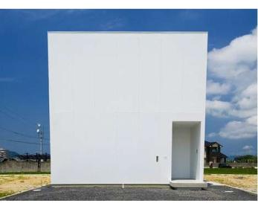
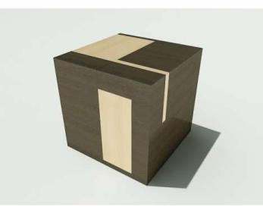
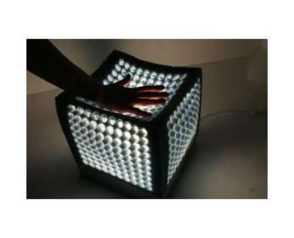





Modern Cubism
Square geometry in design coincides with preference to reduce clutter
Implications - A preference for clean lines in design aesthetic has led to the embrace of the cube silhouette in the design of everything from architecture to furniture. The simple geometric shape of the cube provides a natural representation of the minimalist tendency that is becoming prevalent in consumers' minds.
Score:
This Year and Warm
5.9
Top 8 Examples:
51,480 Total Clicks
Date Range:
Jan 10 - May 10
74782
May / 8.6
68963
Mar / 8.2
63779
Jan / 7.5
White Cube Homes
Brainstorming Furniture
Spongy Soft Lighting
73492
Apr / 6.1
64924
Jan / 5.4
74732
May / 4.7
75093
May / 3.5
66905
Feb / 3.3
Tech
Stacked Cube Dwellings
DIY All Spark Cube
LED Ottomans
Rubix's Cube Loungers
Touchscreen Cubes
http://www.trendhunter.com/id/76796 Copyright © TrendHunter.com. All Rights Reserved

Slide 21










Next Besting (UPDATE)
Consumers bypass traditional brands for the 'next best alternative'
Implications - In our current period of economic uncertainty, consumers are still buying things, but they are becoming more conscious of what they actually need and why. In all categories, they are in pursuit of the 'next best thing'. We coined this term 'Next Besting' in 2008, but we continue to see it play out in all categories, including fashion and technology where budget-friendly alternative products are breaking new ground.
Score:
This Year and Hot
7.8
Top 9 Examples:
62,616 Total Clicks
Date Range:
Feb 10 - Oct 10
70481
Mar / 9.6
84404
Aug / 9.4
89517
Sep / 9.2
77787
Jun / 8.7
88335
Oct / 8.3
Funky Affordable Couture
Billowy Fashion Collaborations
Cheap-Chic Apparel
Budget Designer Bags
Affordable iBooks
83823
Aug / 7.8
70243
Mar / 7.4
66557
Feb / 6.0
88400
Sep / 3.6
89160
Sep / 3.4
Tech
Slick Business Timepieces
Sporty Feminine Fashion
Cheap-Chic For Children
Designer Look-Alike Furnishings
Adorable Eco-Friendly Phones
http://www.trendhunter.com/id/91211 Copyright © TrendHunter.com. All Rights Reserved

Slide 22









Hyperrealism
Real life is simulated in photorealistic artworks that defy deception
Implications - Artists are becoming ever more concerned with the accurate representation of reality, attempting to recreate real life with photorealistic works. In an era of misleading advertising and falsehoods like airbrushing, it follows that consumers will show their concern and appreciation for realism in everything they do and see.
Score:
This Year and Hot
7.9
Top 9 Examples:
56,210 Total Clicks
Date Range:
Apr 10 - Sep 10
82004
Jul / 9.1
83459
Aug / 9.0
84664
Aug / 8.8
87350
Sep / 8.6
86085
Aug / 8.5
Hyperrealistic Fashion Paintings
Feminine Solitude Portraiture
Hyper-Realistic Oils
Hyper-Realistic Pimpmobiles
Hyperrealist Portraits
87083
Sep / 8.3
73426
Apr / 7.9
80478
Jul / 6.5
83797
Aug / 4.3
Art & Design
Realist Oil Paintings
Sensuous Photorealistic Paintings
Lifelike Cinematic Paintings
Hyperrealist Portraits
http://www.trendhunter.com/id/89246 Copyright © TrendHunter.com. All Rights Reserved

Slide 23








Democratic Selling
Online retailers rely on customer votes to push production
Implications - Vote-based selling is gaining momentum in the world of online retail as businesses proactively employ the opinions of their customers. While democratic selling relies on crowdsourcing, it goes one step further by collecting customer votes and basing production entirely on those votes. So, the voice of the customer really is the voice of the customer.
Score:
This Year and Warm
5.5
Top 8 Examples:
36,456 Total Clicks
Date Range:
Jul 09 - Sep 10
49534
Jul / 8.4
65740
Jan / 7.3
75659
May / 7.2
Crowdsourced T-Shirts
On-Demand Furniture
Democratic Fashion Sites
88334
Sep / 5.6
65790
Jan / 4.8
57462
Oct / 4.3
63103
Jan / 3.4
74239
May / 3.1
Business
Democratic Fashion Merchandising
Democratic Bamboo Chairs
Crowdsourced Fashionocracies
Crowd-Designed Greeting Cards
Crowdsourced Chairs
http://www.trendhunter.com/id/88912 Copyright © TrendHunter.com. All Rights Reserved

Slide 24








Luxury Lives On
Despite economy, airlines up the ante with extravagant extras
Implications - Economic uncertainty may be causing most strategies to become more conservative, but indulgence-loving consumers remain. Recognizing this, some airlines are transforming their high-class cabins to include extremely extravagant services. And if a carrier can maintain low prices at the economy level as well, it may well be able to secure upper-class and budget-conscious travelers.
Score:
This Year and Warm
6.3
Top 7 Examples:
22,609 Total Clicks
Date Range:
Dec 09 - Aug 10
83193
Jul / 8.3
85411
Aug / 8.2
82773
Jul / 7.7
Personal Airplane Rooms
Business Class Bedrooms
Spacious Business Jets
76526
May / 7.3
62824
Dec / 4.8
78385
Jun / 4.3
79555
Jun / 3.2
Luxury
Sound-Proof Flights
Friendly Futuristic Airplanes
Personal Jet Renting
Gilded Airplane Storage
http://www.trendhunter.com/id/89607 Copyright © TrendHunter.com. All Rights Reserved

Slide 25













Geriatric Couture
Seniors become the anti-fashion inspiration for young people
Implications - Geriatric-inspired fashion is gaining ground in both personal and runway style. Looking to their grandparent's closets, young people are finding madcap prints, old-school crochet and excessive embroidery à la mode. By remixing what was previously considered bland, the modern granny style can be considered anti-fashion for those looking to rebel against more trendy ensembles.
Score:
This Year and Warm
6.4
Top 9 Examples:
92,852 Total Clicks
Date Range:
Dec 09 - Aug 10
75896
May / 8.5
78718
Jun / 7.9
60929
Dec / 6.5
83533
Aug / 6.3
70623
Mar / 6.0
79885
Jun / 5.8
Arts & Crafts Fashion
Graffitied Pictorials
Luxury Grandma Totes
Granny Prepster Looks
Romantic Sport Fashion
Mad Lady Pictorials
72271
Apr / 5.5
76933
May / 5.5
78319
Jun / 5.3
68303
Feb / 5.0
76570
May / 4.7
76595
May / 4.3
Pop Culture
Designer Granny Panties
Vintage Granny Fashiontography
Madcap Mixed Prints
Psychedelic Granny Booties
Cross-Stitched Rap
Cross-Stitched Cufflinks
http://www.trendhunter.com/id/83776 Copyright © TrendHunter.com. All Rights Reserved

Slide 26












Rockstar Self-Expressionism
Rock 'n' roll styling and attitude receive newfangled attention
Implications - Rock 'n' roll is no longer a subculture, but something that inspires many facets of mainstream innovation. The renewed fascination with the rockstar lifestyle has trickled into industries from fashion to marketing, in which the glamorous life and hard attitude of rock 'n' roll is revived through ripped jeans and studded jackets, and rock-themed accommodations, events and artwork.
Score:
This Year and Warm
7.5
Top 9 Examples:
92,872 Total Clicks
Date Range:
Oct 09 - Jun 10
58964
Nov / 9.3
59785
Nov / 8.6
62054
Dec / 8.5
70674
Mar / 8.2
77322
Jun / 7.9
58018
Oct / 7.4
Rockin' Hotel Rooms
Hipster Rockstar Shoots
Rock n Roll Editorials
Aspiring Rockstar Couture
Rockstar Beach Fashion
Goth Rocker Couture
60427
Nov / 7.1
76066
May / 5.3
58356
Nov / 5.1
76833
Jun / 4.4
60181
Nov / 4.2
65442
Jan / 3.6
Fashion
Rock Star Chic Shoes
Rockstar Portraiture
Rockstar Cakes
Rockstar Barn Fashion
Rockstar Wines
Rockstar Soda Promos
http://www.trendhunter.com/id/78555 Copyright © TrendHunter.com. All Rights Reserved

Slide 27
Get 1,000+ More!
Find more at TrendHunter.com/TrendReports

